Slide 1
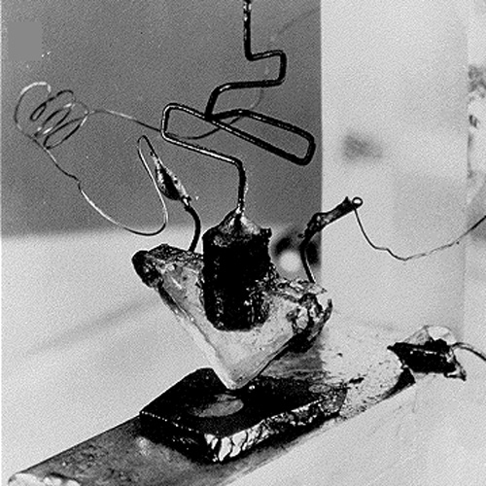
Transistors
Week 5
First transistor, 1947, Bell Labs
5-2

Slide 2
Sierra 2111 schedule
Sierra 2111 is available TTh 1:30-4:30pm, and you’re welcome to attend the class there
Other current events:
  Global climate strike https://fridaysforfutureusa.org/sept-23/, https://twitter.com/ycstrikeLA
  Amanda Gorman opens UN General Assembly
    https://www.youtube.com/watch?v=wW6hoiyYiUI

Slide 3
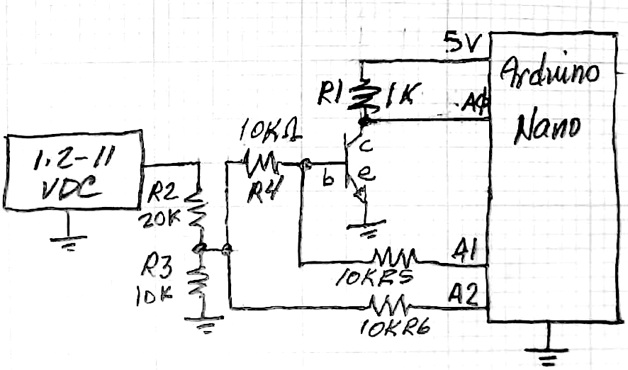
Transistor switch circuit
A BJT transistor switches on when Vbe > ~0.6-.7V so we need to reduce the voltage of our LM317 power supply
→ voltage divider
The collector is powered
from the Arduino’s 5V,
so only the base voltage
(and current) are independent
variables
Base current = (A2-A1)/10kΩ
A0 measures collector voltage

Slide 4
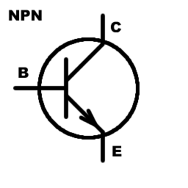

BJT Golden Rules
There are no golden rules … there are many
configurations and possibilities with BJTs…
The base-emitter often acts like a diode
  If V_{be} < ~0.6V then i_{c} ~ 0 and the transistor is “off”
  If V_{be}~0.6-0.7V (forward biased diode), the collector-emitter conducts
  Making V_{be}>0.7V will likely destroy the device quickly
If not saturated, i_{c} = h_{fe} * i_{b}
The transistor will lower its collector-emitter voltage in order to satisfy (3.) But it can’t go below V_{ce}~ 0.01-0.3V
Like diodes (e.g., LEDs), external components are generally needed to limit base and collector currents at safe (for the device) values
…

Slide 5
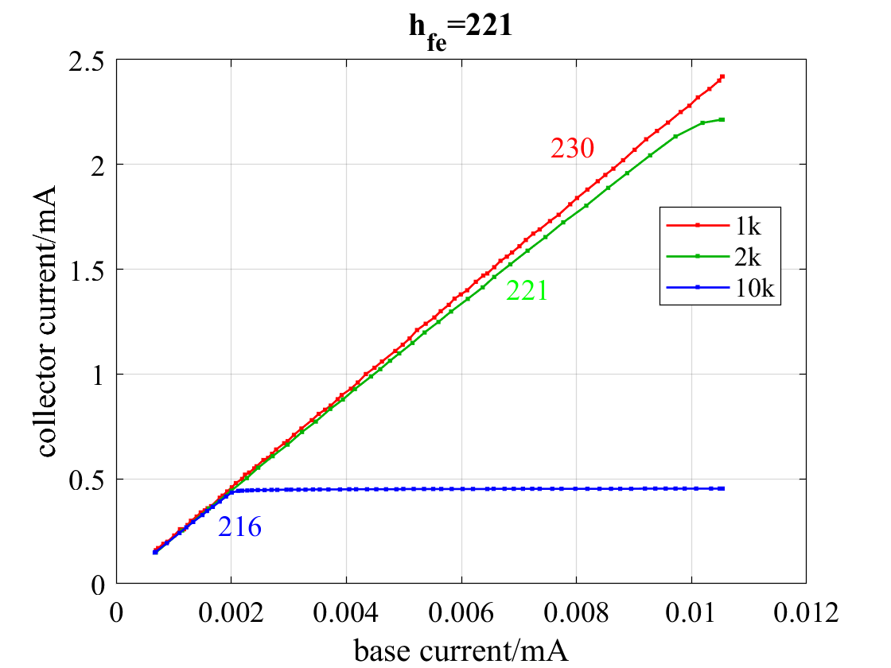
Saturation
>> indx = ic < .006;
>> p = polyfit(ib(indx), ic(indx), 1)
ans =
331.0971 0.0037
>> mean(ic(~indx))
ans =
2.2285
>> (Vref-min(data1(:,3)))/2
ans =
2.2550
R_{c} = 2kΩ saturated i_{c} at 2.23mA,
with V_{CE} = 0.23V – the transistor
couldn’t go lower

Slide 6

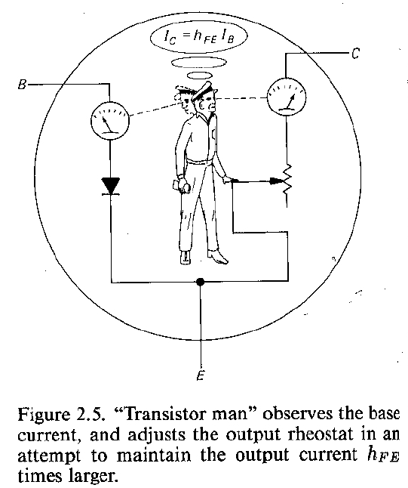
What happens in saturation?
V_{cc}
R_{c}
“Transistor man” adjusts a variable resistor that’s a voltage divider with R_{c}. Once set to its minimum value (R=V_{ce}/i_{c}), it can’t go any lower
i_{c} is now saturated at (V_{cc}-V_{ce})/R_{c}, additional increase in i_{b} cannot increase i_{c}
In saturation, the external collector circuitry (R_{c}) determines i_{c}, not h_{fe}i_{b}.
How do you feel about this model?

Slide 7
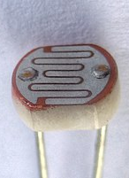
Design Challenge
Objective: Make an LED night light that automatically turns on in dark, and turns off in light
Methods:
  Characterize a CdS photoresistor (https://en.wikipedia.org/wiki/Photoresistor)
    Use your ohmmeter to measure its resistance under light and dark conditions
  Design a transistor switch to turn on/off an LED based, controlled by the CdS photoresistor
  Prototype and test (and iterate) – remember, that design is more of a circular or spiral process than a linear one

